Slide 1
CHAPTER 7
Sampling

Slide 2
Chapter Outline
Generalizability: To what extent does the sample represent the population?
Interrogating external validity: What matters most?
Notes:
Chapter 7 is comprised of two large sections. The first section focuses on generalizing from the sample to the population, and the second section examines what is most important when interrogating external validity.

Slide 3
Chapter Topics
Populations and samples
When is a sample biased?
Obtaining a representative sample: Probability sampling techniques
Settling for an unrepresentative sample: Biased sampling techniques
Notes:
This slide presents the headings for the “Generalizability” section.
This chapter focuses on external validity, which is especially important for frequency claims. For example: Do the people sampled in mock pre-election polls for president of the United States represent all registered voters or all voters who will vote in the election (as some registered voters do not vote)?

Slide 4
Definitions
Sampling – The process of selecting observations from a population
Population == All members of a particular group

Slide 5
Why Sample?
Populations vary greatly in size
  Small population?
  Large population?
For most psychologists, our target population is all people.
Cannot measure all people!

Slide 6
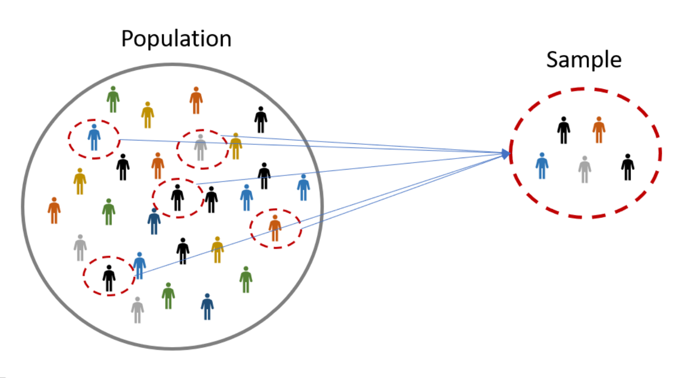
Samples vs. Populations (1)

Slide 7
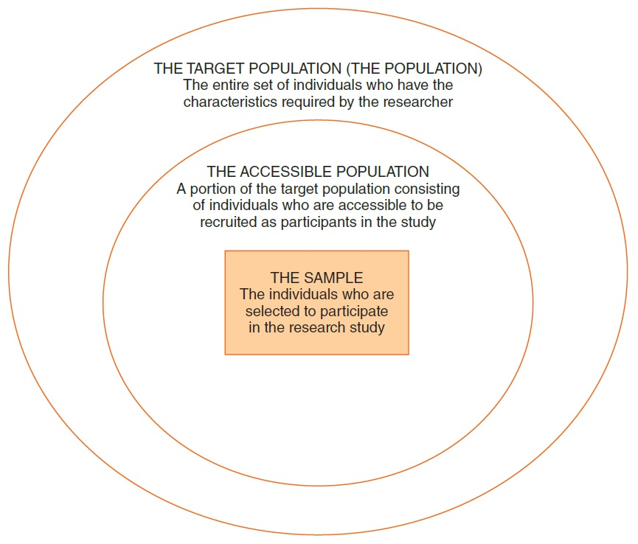
Samples vs. Populations (2)
Notes:
Figure 5.2 The Relationship Among the Target Population, the Accessible Population, and the Sample

Slide 8
Sampling Considerations
Who is your sample?
Where will you recruit them from?
Do they accurately reflect the population?

Slide 9

1936 Presidential Election (1)
President Alf Landon

Slide 10
1936 Presidential Election (2)
President Alf Landon
  Literary Digest poll, 1936
  Two million ballots mailed to people listed in telephone directory
  Ballots predicted a large Landon Victory

Slide 11
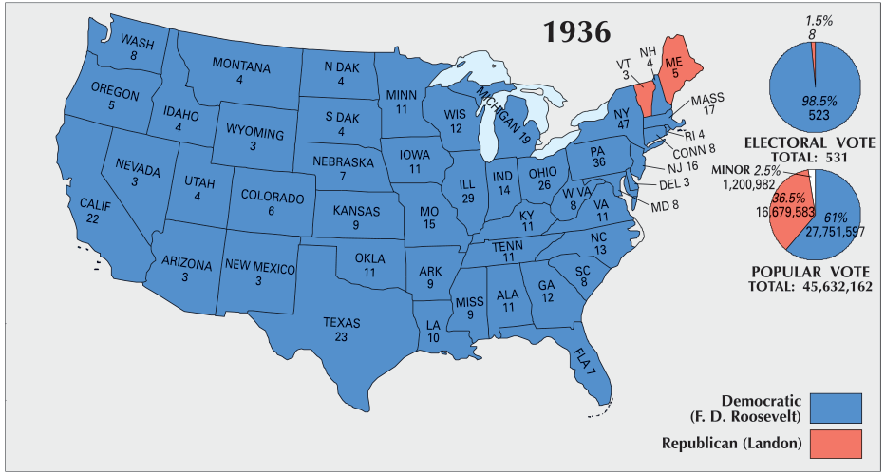
1936 Presidential Election (3)

Slide 12
1936 Presidential Election (4)
What went wrong?
Pre-election polling was flawed!
  Based on the “Literary Digest Poll”
    Based on a sample of 2.7 million individuals
    Poll began in 1916
      Always predicted the correct winner

Slide 13
1936 Presidential Election (5)
Flawed Polling
Literary Digest primarily polled its own readers, car owners, and telephone owners
  Wealthy!
Selection (sampling) bias!
  Most people voting for FDR didn’t respond to the poll!

Slide 14
1948 Presidential Election (1)
Thomas Dewey vs. Harry S Truman
Dewey predicted to win in a landslide

Slide 15
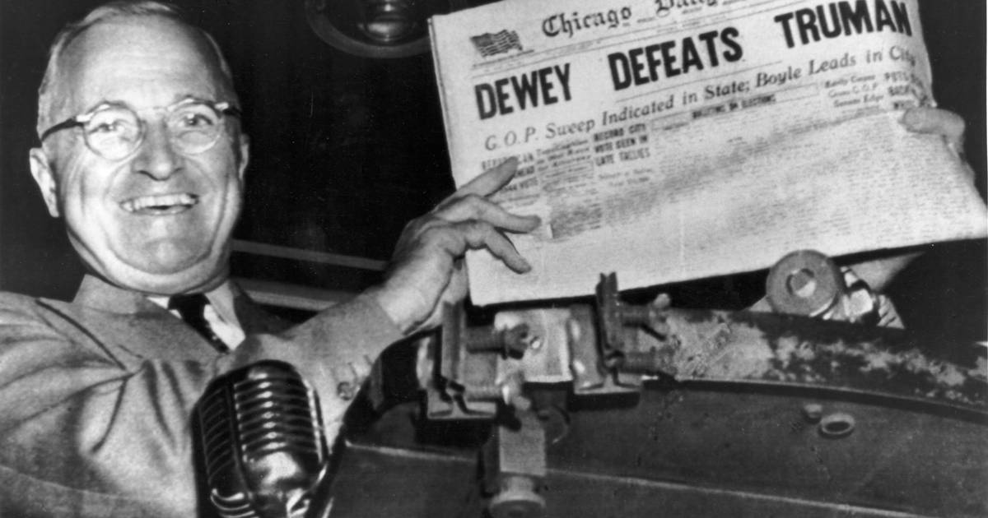
1948 Presidential Election (2)
“President” Thomas E. Dewey
  Gallup’s quota sampling
  Problems?

Slide 16
1948 Presidential Election (3)
Gallup’s quota sampling
Quota frames were based on 1940 census
  Urban migration during WWII
  Underrepresented urban masses
Stopped polling in October 1948 (~ 1 month before election day)

Slide 17
Sample Size (1 of 2)
Researcher’s goal ► select a sample that is representative of the population.
Law of large numbers: a large sample will probably be more representative than a small sample.
A sample size of 25-30 individuals for each group or treatment condition is a good target for many studies.

Slide 18
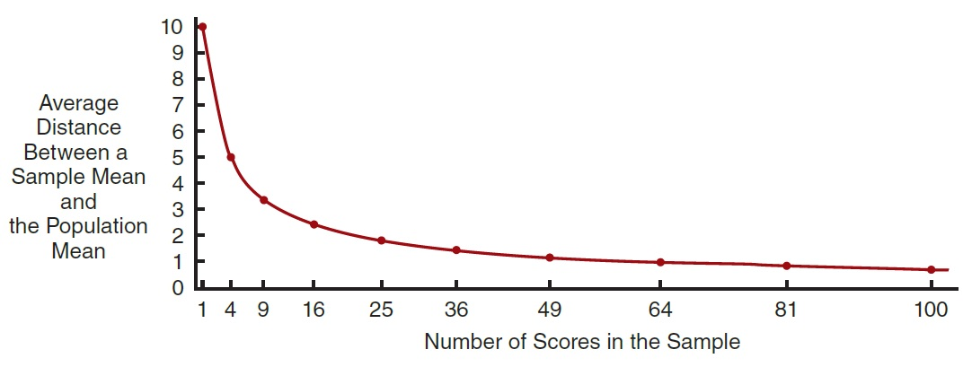
Sample Size (2 of 2)
Notes:
Figure 5.3 The Average Distance between a Sample Mean and the Population Mean as a Function of Sample Size
Note that the larger the sample, the more accurately the sample represents the population. However, representativeness increases in relation to the square root of the sample size.

Slide 19
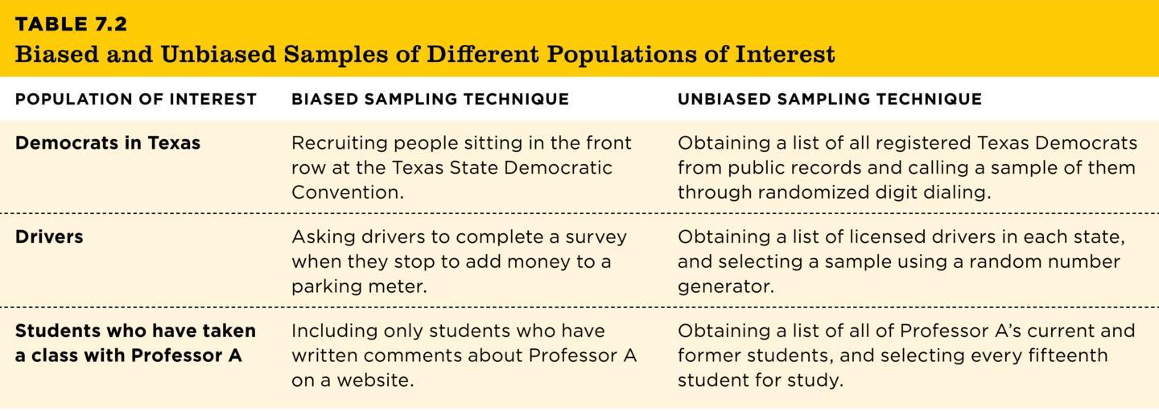
Coming from a Population Versus Generalizing to That Population
Biased Sample
Representative Sample
Table 7.2
TABLE 7.2 Biased and Unbiased Samples of Different Populations of Interest
POPULATION OF INTEREST | BIASED SAMPLING TECHNIQUE | UNBIASED SAMPLING TECHNIQUE
Democrats in Texas | Recruiting people sitting in the front row at the Texas State Democratic Convention. | Obtaining a list of all registered Texas Democrats from public records and calling a sample of them through randomized digit dialing.
Drivers | Asking drivers to complete a survey when they stop to add money to a parking meter. | Obtaining a list of licensed drivers in each state, and selecting a sample using a random number generator.
Students who have taken a class with Professor A | Including only students who have written comments about Professor A on a website. | Obtaining a list of all of Professor A’s current and former students, and selecting every fifteenth student for study.
Notes:
Table 7.2: Biased and Unbiased Samples of Different Populations of Interest
For a sample to be representative of a population, it must come from the population. But researchers also need to consider how the sample was selected. Samples are either biased or representative of the population from which they are drawn.
In a biased sample (unrepresentative sample), not all members of a population have an equal probability of being included. In an unbiased sample (representative sample), all members of the population have an equal probability of being included. We can only make inferences from the sample to the population of interest when we have a representative sample.
Copyright © 2025 W. W. Norton & Co., Inc.

Slide 20
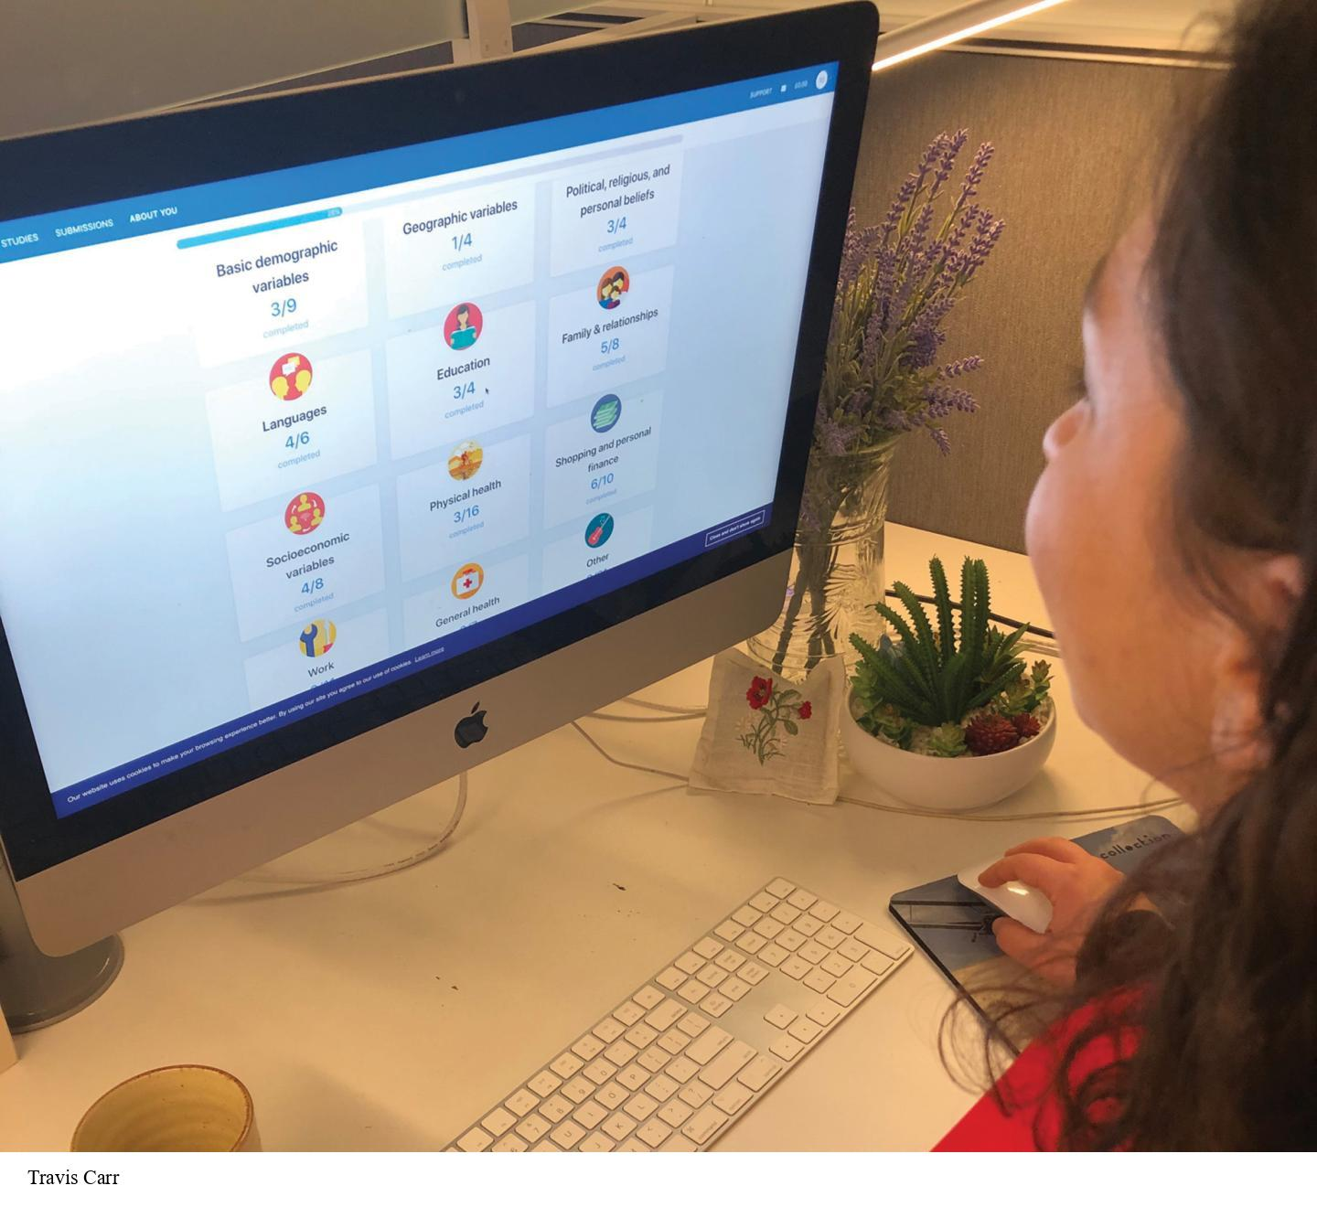
Ways a Sample May Be Biased (1 of 2)
Sampling only those who are easy to contact
  Convenience sampling
  Example?
Notes:
Figure 7.2: Online Studies Normally Use Convenience Samples
People who participate in online research for payment, such as at the Prolific Academic website, are considered a convenience sample. How might they differ from college student samples or from representative samples of people from the same country?
There are at least two ways to get a biased sample, and a biased sample can threaten the study’s external validity. One of those ways is by sampling only those individuals who are easiest to contact, which is known as convenience sampling.
Example: In the last 10 years, psychologists have been conducting research through websites such as Amazon’s Mechanical Turk and Prolific Academic (Figure 7.2). People who want to earn money for participating in research can do so online. Even though these samples are convenient, people who complete studies on websites sometimes show personality traits and political beliefs that differ slightly from members of other adult samples (Clifford et al., 2015; Goodman et al., 2013).
Travis Carr

Slide 21
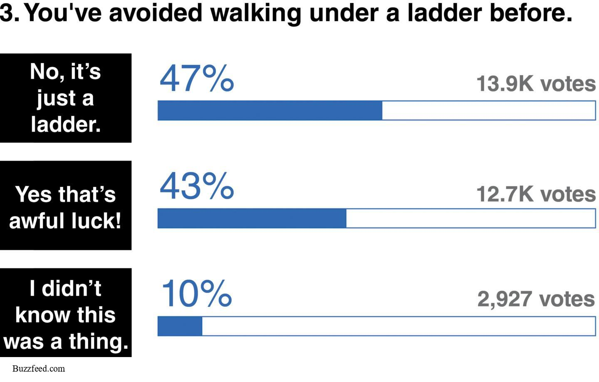
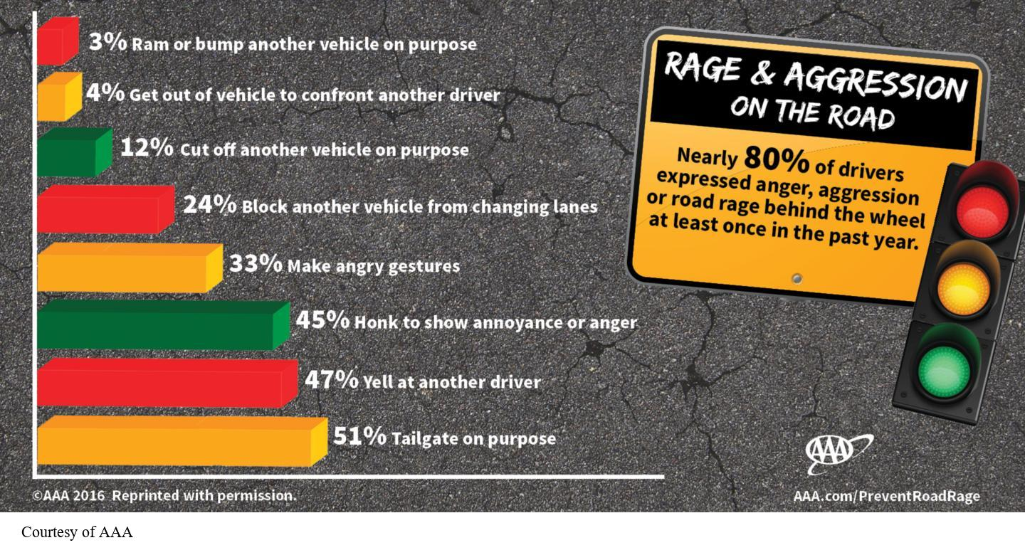
Ways a Sample May Be Biased (2 of 2)
  Sampling only those who volunteer
  Self-selection
Notes:
Figure 7.3: Some Internet Polls Are Based on Self-Selected Samples
This poll was posted on BuzzFeed.com. Why can’t we generalize from this sample of over 20,000 to the population of young adults who read BuzzFeed?
Figure 7.3 shows an online poll that invited readers to vote on if they’ve walked under a ladder before. Can we generalize from this sample of 20,000 to the population of young adults who read BuzzFeed?
Self-selection is a type of biased sampling in which only people who volunteer participate in a study. Self-selection is especially prevalent in online polls.
Buzzfeed.com
Figure 7.4: Some Internet Polls Are Based on Random Samples
The data in this figure came from an online survey on road rage. Respondents were part of an Internet panel that had been randomly sampled and invited to respond, so we can probably generalize from this poll to the population of American drivers. (Source: AAA.com.)
The data in Figure 7.4 came from an online survey on road rage. The respondents had been randomly sampled and invited to respond, so we can probably generalize from this poll to the population of American drivers. Moreover, respondents could endorse multiple behaviors on the list.
Courtesy of AAA

Slide 22
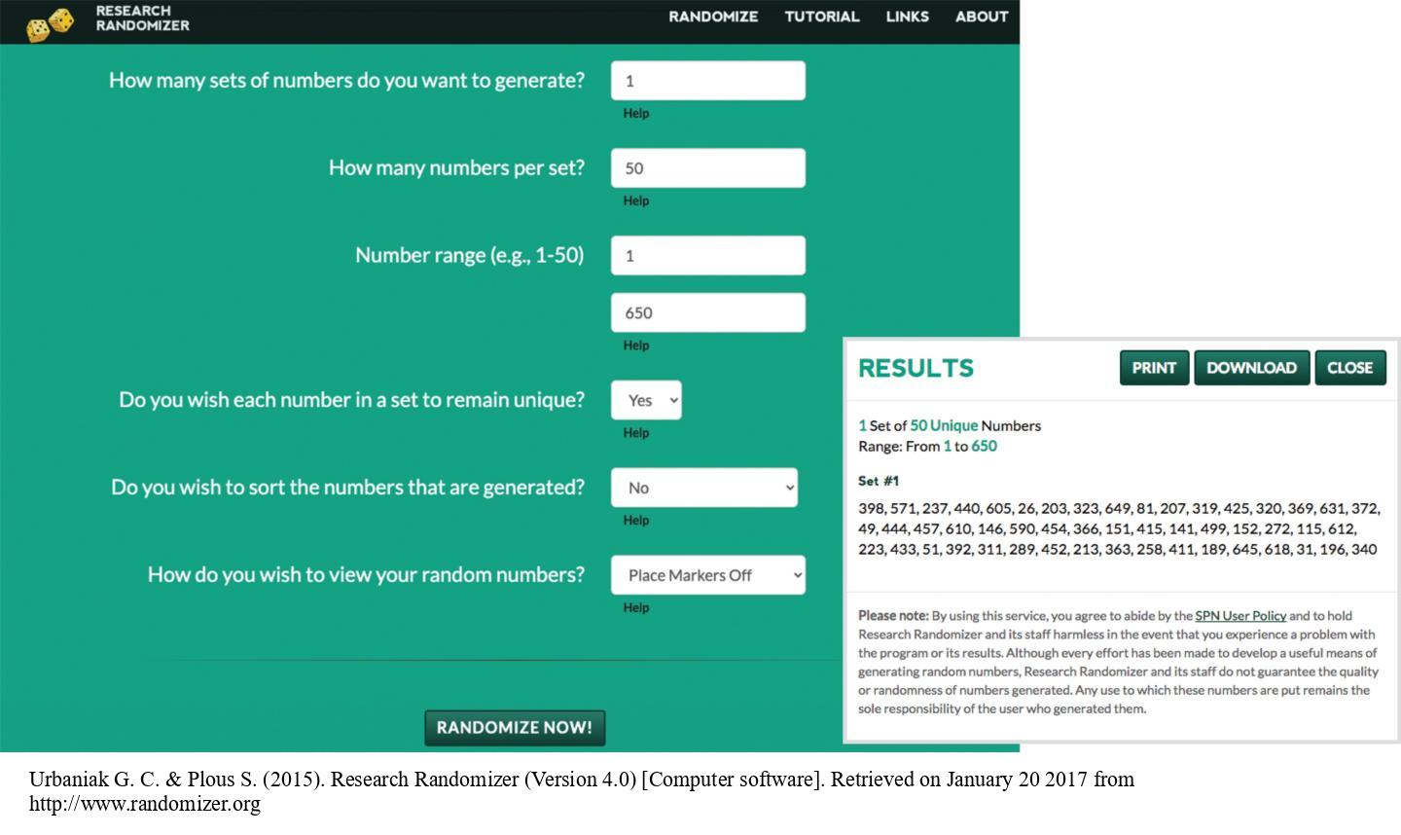
Obtaining a Representative Sample: Probability Sampling
Techniques (1 of 2)
Probability sampling
  Simple random sampling
Notes:
Figure 7.5: Computerized Randomizers
This website generates lists of random numbers. In this example, the user requested a list of 50 random members of a population of 650. Each individual in the original population must first be assigned a number from 1 to 650. The randomizer tool determines which of the 650 individuals should be in the random sample of 50. (Source: randomizer.org.)
When external validity is crucial, researchers need to obtain a representative sample. The best way of getting such a representative sample is by using probability sampling (also known as random sampling), in which every member of the population of interest has an equal chance of being selected for the sample.
There are a number of kinds of random sampling. One kind is simple random sampling, which can be obtained by putting every member’s name of your population of interest in a pool and then randomly selecting a predetermined number of names from the pool to include in your sample.
Another way to obtain a simple random sample is to assign a number to each member of the population and then use a table of random numbers to select your sample.
Random sampling can be very difficult to do and also time-consuming. In some cases, it’s impossible to do if you cannot enumerate your population of interest. In these cases, you might use variations of simple random sampling that are equally externally valid.
Urbaniak G. C. & Plous S. (2015). Research Randomizer (Version 4.0) [Computer software]. Retrieved on January 20 2017 from http://www.randomizer.org

Slide 23
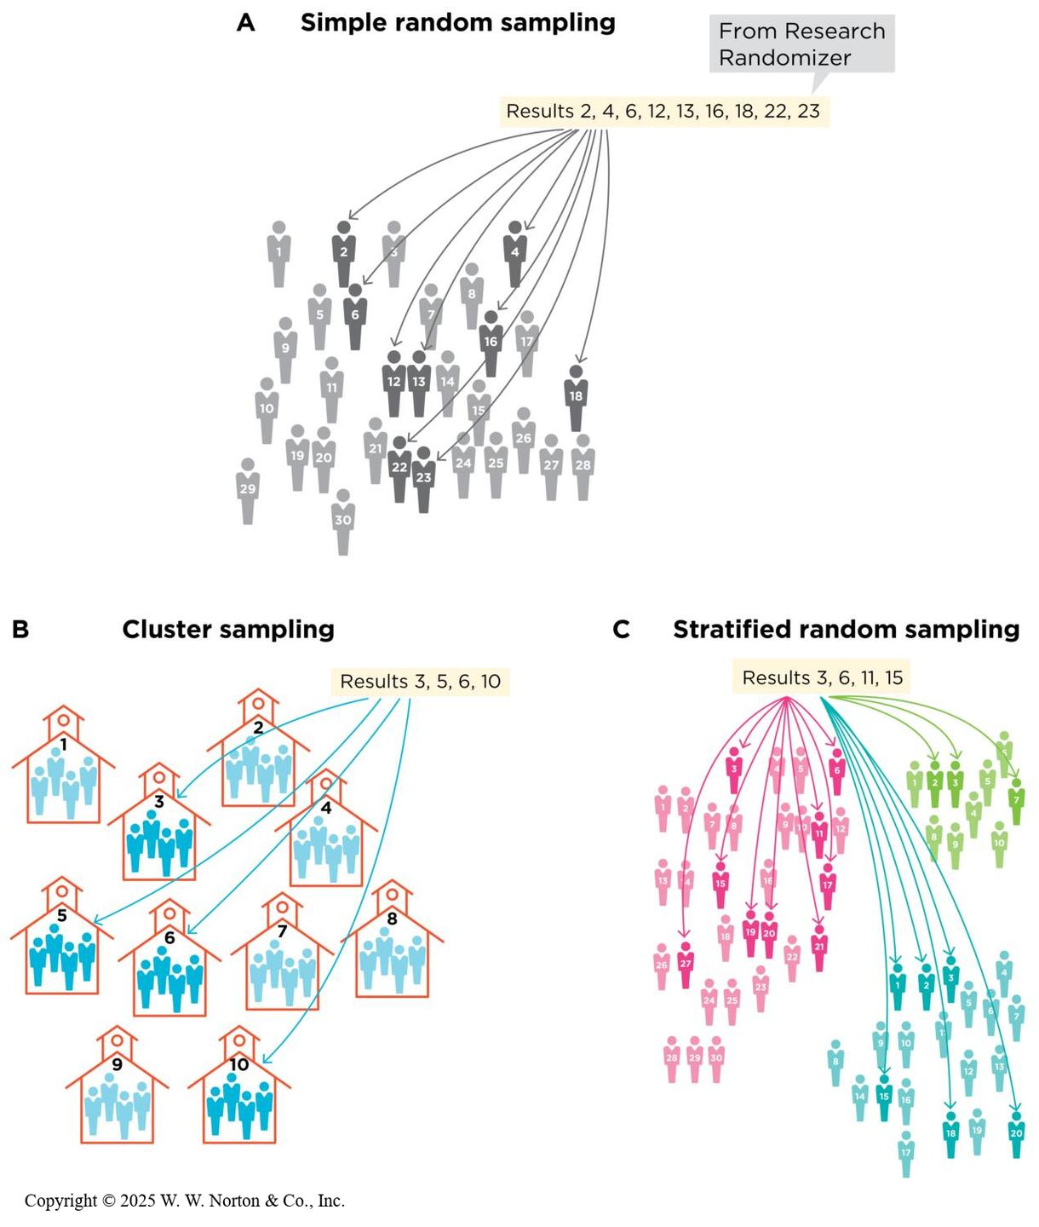
Obtaining a Representative Sample: Probability Sampling
Techniques (2 of 2)
  Probability sampling
  Systematic sampling
  Cluster sampling
  Multistage sampling
  Stratified random sampling
  Oversampling
Notes:
Figure 7.6: Three Common Forms of Probability Sampling
(A) To obtain a simple random sample of 10 of these 30 individuals, we requested 10 random numbers from Research Randomizer. (B) To obtain a cluster sample, we selected 4 of these 10 schools at random (using Research Randomizer). We will study all the students within each selected school. (C) To obtain a stratified sample of hospital employees, we first divided this population into three meaningful strata: 10 social workers, 20 doctors, and 30 nurses. We randomly selected 3 social workers, 6 doctors, and 9 nurses. Therefore, our sample’s proportions of social workers, doctors, and nurses are proportional to those in the full population. (In practice, the samples studied will be much larger than those depicted here.)
Other types of probability sampling:
Systematic sampling: If I wanted to systematically sample this class, I could roll two dice. Let’s say one lands on five and the other lands on three. I would start at the fifth person in the class and then choose every third person until the sample reached the desired size.
Cluster sampling: Clusters of participants within a population of interest are randomly selected, and then all individuals in each selected cluster are used. For example, suppose your population of interest is preschools within the city in which you live. If a researcher wanted to randomly sample high school students in the state of Pennsylvania, for example, he could start with a list of the 952 public high schools (clusters) in that state, randomly select 100 of those high schools (clusters), and then include every student from each of those 100 schools in the sample.
Multistage sampling: Two random samples are collected. Stage 1: A random sample of clusters is selected from your population of interest. Stage 2: From those selected clusters, a random sample of people is chosen. For example, a researcher starts with a list of high schools (clusters) in the state and selects a random 100 of those schools. Then, instead of selecting all students at each school, she selects a random sample of students from each of the 100 selected schools.
Stratified random sampling: A multistage technique in which the researcher selects specific demographic categories (such as race or gender) and then randomly selects individuals from each of the categories. For example, a group of researchers might want to be sure their sample of 1,000 Canadians includes people of South Asian descent in the same proportion as in the Canadian population (which is 4%). Thus, they might have two categories (strata) in their population: South Asian Canadians and other Canadians.
Oversampling is a variation of stratified random sampling in which a researcher over represents one or more groups. For example, perhaps a researcher wants to sample 1,000 people, making sure to include South Asians in the sample. Maybe the researcher’s population of interest has a low percentage of South Asians (say, 4%). Because 40 individuals may not be enough to make accurate statistical estimates, the researcher decides that of the 1,000 people he samples, a full 100 will be sampled at random from the Canadian South Asian community.
Copyright © 2025 W. W. Norton & Co., Inc.

Slide 24
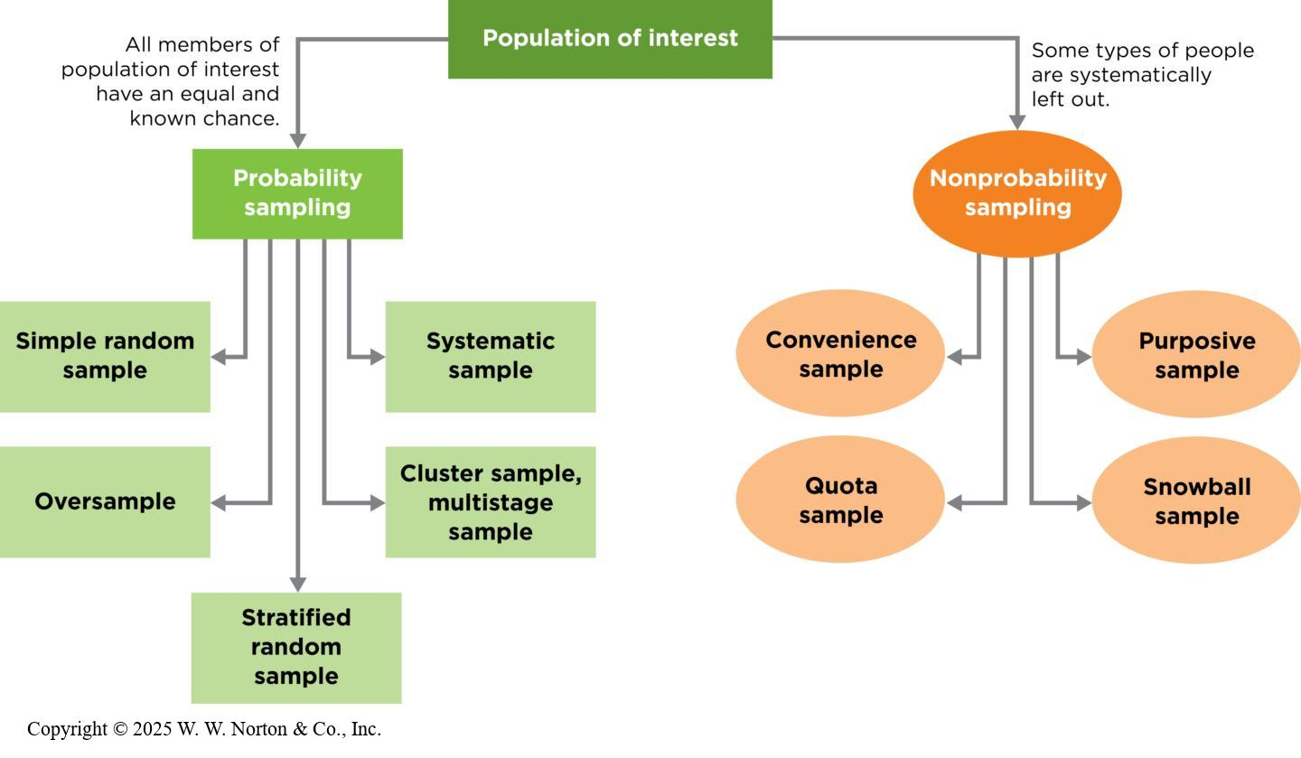
Combining Techniques
Notes:
Figure 7.7: Probability and Nonprobability Sampling Techniques
Probability sampling techniques all involve an element of random selection and result in samples that resemble the population. Nonprobability sampling techniques are biased because they exclude systematic subsets of individuals; their ability to generalize to the population is unknown.
Sometimes the sampling techniques mentioned here are combined. Figure 7.8 is an overview of representative and biased sampling techniques.
Copyright © 2025 W. W. Norton & Co., Inc.

Slide 25
Random Sampling and Random Assignment
Random sampling
  Increases external validity
Random assignment: used only in experimental designs to assign participants to groups at random
  Increases internal validity
Notes:
It is important not to confuse random sampling with random assignment.
Random sampling: creating a sample using some random method so that each member of the population of interest has an equal chance of being in the sample; this method increases external validity.
Random assignment: only used in experiments; participants are randomly put into different groups (usually a treatment group and a comparison group); this method increases internal validity.

Slide 26
Settling for an Unrepresentative Sample: Nonprobability Sampling Techniques
Convenience sampling
Purposive sampling
Snowball sampling
Quota sampling
Notes:
If external validity is not a top priority, then unrepresentative or biased sampling may be used.
Convenience sampling: samples that are easy to access; this is a common technique in behavioral research.
Purposive sampling: used when you want to study certain kinds of people, so you only recruit those types of participants. For example, if you wanted to recruit smokers, you might recruit participants from a tobacco store.
Snowball sampling: a variation on purposive sampling in which participants are asked to recommend other participants for the study. For example, for a study on coping behaviors in people who have Crohn’s disease, for example, a researcher might start with one or two who have the condition, and then ask them to recruit people from their support groups. Each of them might, in turn, recruit one or two more acquaintances, until the sample is large enough. Snowball sampling is unrepresentative because people are recruited via social networks, which are not random.
Quota sampling: similar to stratified random sampling; the researcher identifies subsets of the population and then sets a target number (i.e., a quota) for each category in the sample. Then she uses nonrandom sampling until the quotas are filled. For example, you would like to have 20 college freshman, 20 sophomores, 20 juniors, and 20 seniors in your sample. You know some people in each of these categories but not 20 of each, so you might use snowball sampling until you meet your quota of 20 in each subset.

Slide 27
Interrogating External Validity: What Matters Most? (1 of 2)
In a frequency claim, external validity is a priority.
Cases where external validity is a lower priority
  Nonprobability samples in the real world
  Nonprobability samples in research studies
Notes:
When external validity is a priority:
External validity is very important when making frequency claims because you are reporting on how often something happens in a population.
Example: “8 out of 10 Drivers Say They Experience Road Rage”: If the driving study used sampling techniques that contained mostly urban residents, the road rage estimate might be too high because urban driving may be more stressful.
When external validity is a lower priority: Even though you need a probability sample to support a frequency claim, many associations and causes can still be accurately detected even in a nonprobability sample.
Nonprobability samples in the real world: When you know a sample is not representative, you should think carefully about how much it matters. Are the characteristics that make the sample biased actually relevant to what you are measuring? In certain cases, it’s reasonable to trust the reports of unrepresentative samples.
Example: Let’s say a driver uses the Waze navigation app to report heavy traffic on a specific highway. This driver is not a randomly selected sample of drivers on that stretch of road; in fact, this driver is more conscientious and thus more likely to report problems. However, these traits are not that relevant. Traffic is the same for everybody, conscientious or not, so even though this driver is a nonrandom sample, their traffic report can probably generalize to the other drivers on that road. The feature that has biased the sample (being conscientious) is not relevant to the variable being measured (being in traffic).
Nonprobability samples in the research studies: Recall from Chapter 6 the 30 caregiver-infant pairs who allowed the researchers to observe their gaze patterns during everyday interactions (Franchak et al., 2016). Only certain kinds of caregivers will agree to participate in such observational studies involving detailed tracking of gaze behavior. Does this affect the conclusions of the study? It seems possible that caregivers who volunteer for such close monitoring may be more attentive or responsive than the full population of caregivers. Without more data on caregiver-infant pairs who do not readily agree to participate, we cannot know for sure. The researchers may have to accept some uncertainty about the generalizability of their data.

Slide 28
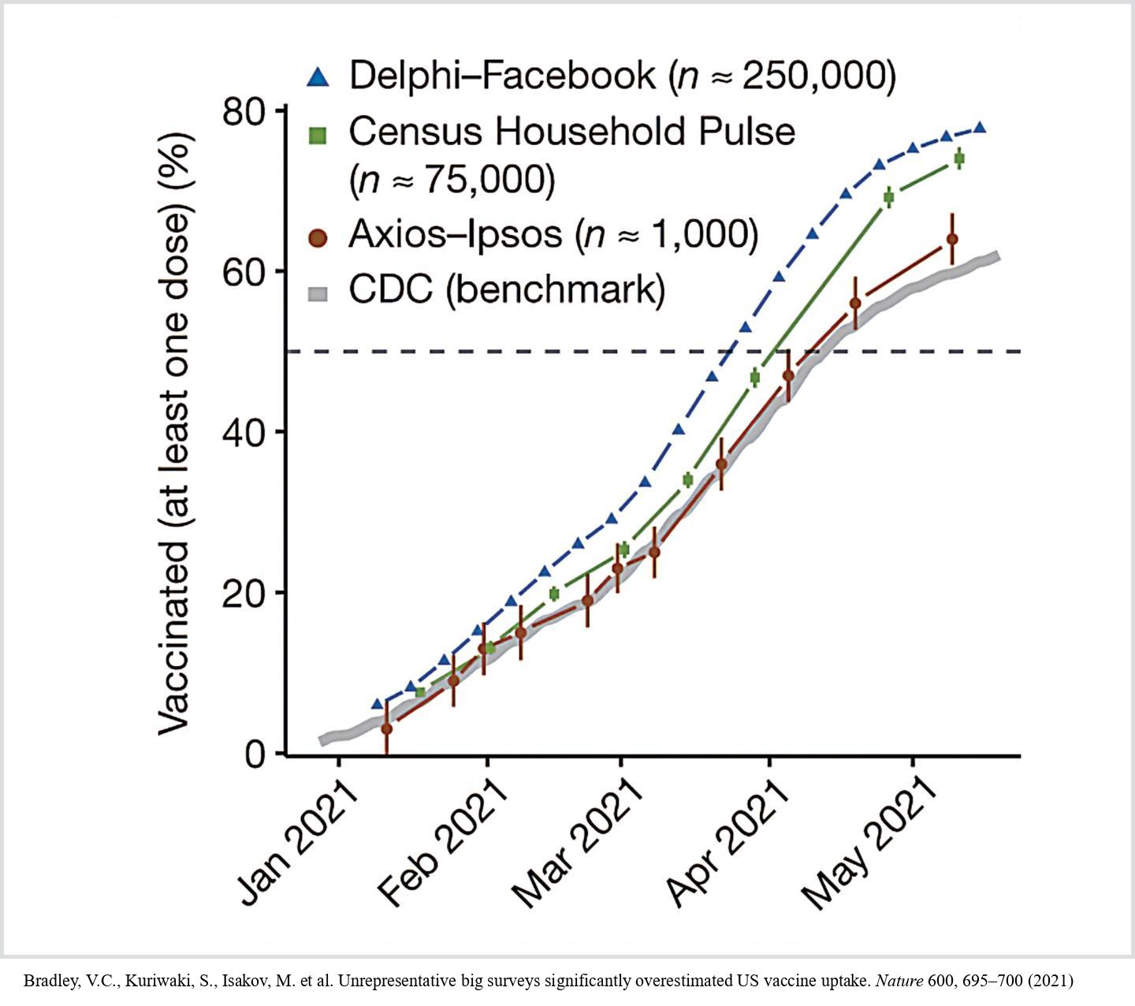
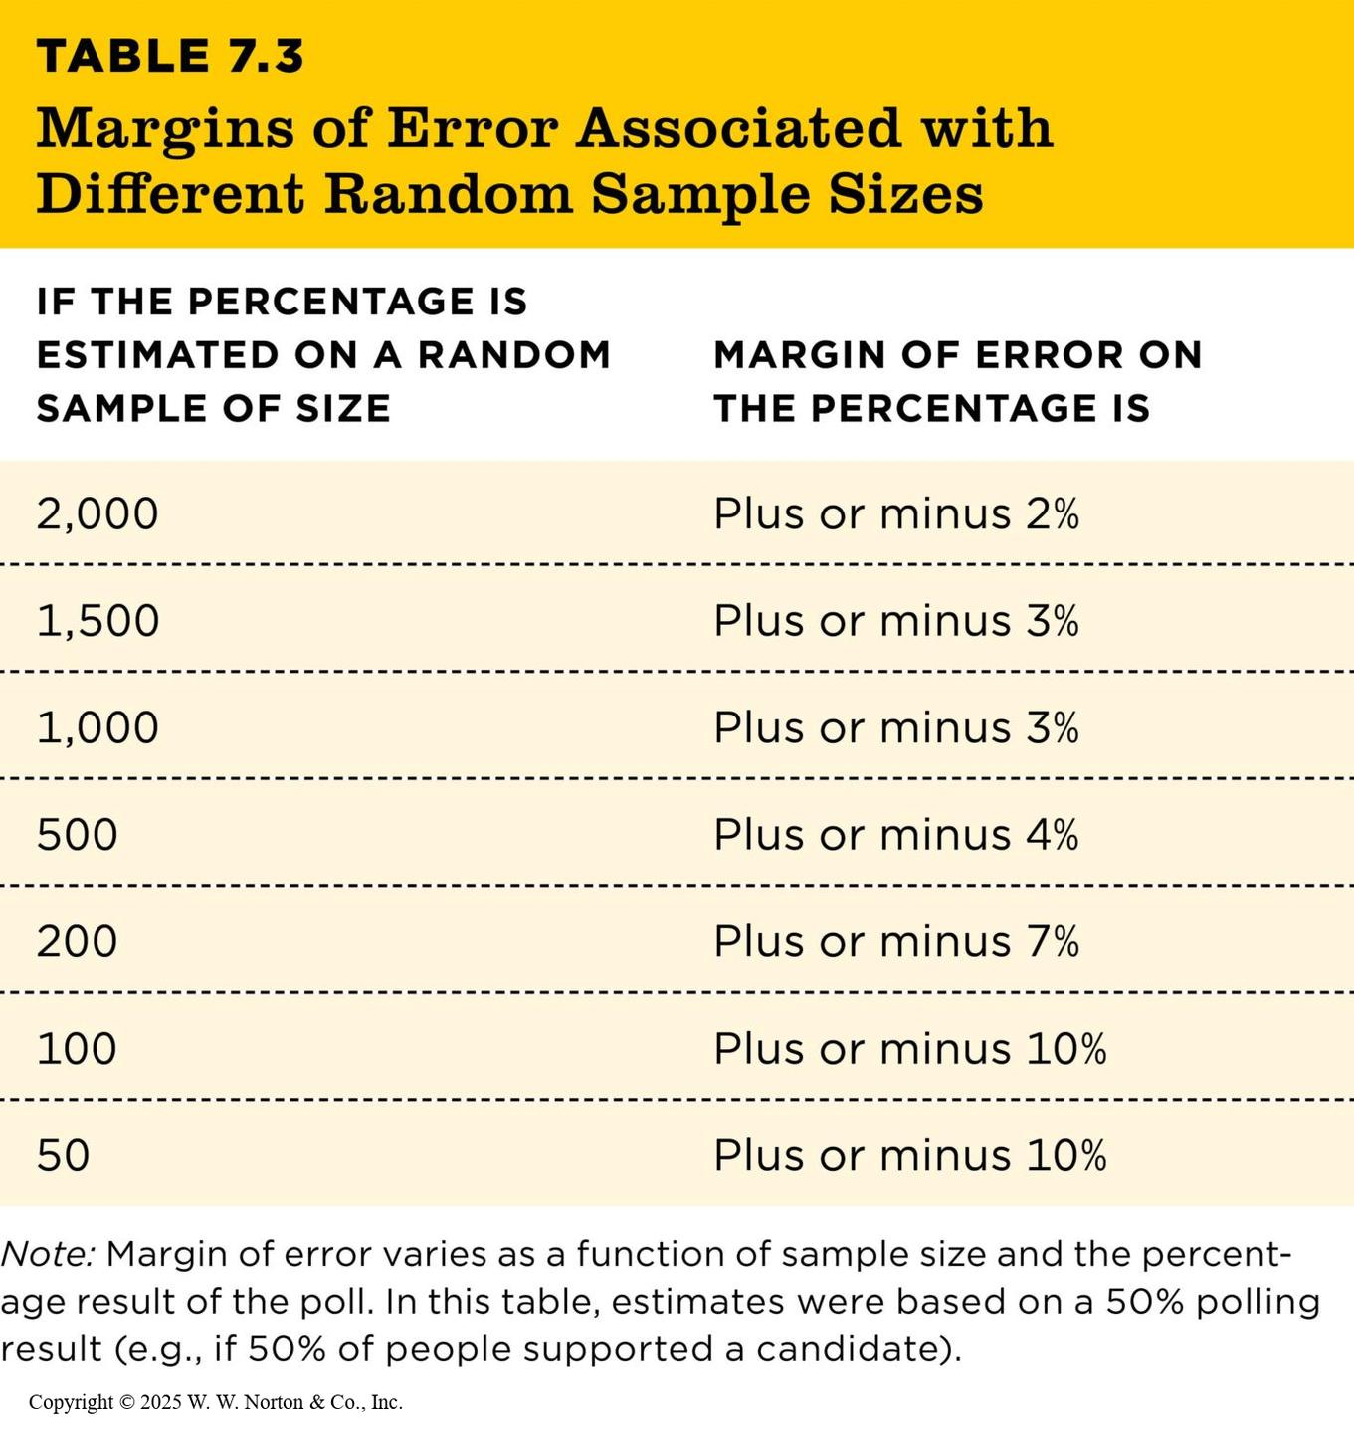
Interrogating External Validity: What Matters Most? (2 of 2)
  Sampling technique, not sample size, determines external validity.
Table 7.3
TABLE 7.3 Margins of Error Associated with Different Random Sample Sizes
IF THE PERCENTAGE IS ESTIMATED ON A RANDOM SAMPLE OF SIZE | MARGIN OF ERROR ON
THE PERCENTAGE IS
2,000 | Plus or minus 2%
1,500 | Plus or minus 3%
1,000 | Plus or minus 3%
500 | Plus or minus 4%
200 | Plus or minus 7%
100 | Plus or minus 10%
50 | Plus or minus 10%
Note: Margin of error varies as a function of sample size and the percentage result of the poll. In this table, estimates were based on a 50% polling result (e.g., if 50% of people supported a candidate).
Notes:
Figure 7.10: Bigger Data Is Not More Accurate
The CDC (gray line) records the true vaccination rate in the United States. The Axios-Ipsos poll was almost perfectly accurate despite its smaller sample (note that its error bars are the widest because of its smaller sample size). In contrast, the largest survey (Delphi-Facebook) was the least accurate, overestimating vaccination rates by 15%. Its huge sample size made it the most precise (the error bars are almost invisible), but it still missed the mark because it systematically excluded people who don’t use the Internet. (Source: Bradley et al., 2021.)
Bradley, V.C., Kuriwaki, S., Isakov, M. et al. Unrepresentative big surveys significantly overestimated US vaccine uptake. Nature 600, 695–700 (2021)
Table 7.3: Margins of Error Associated with Different Random Sample Sizes
The bigger sample is not always the better sample. We need to take into account how that sample was obtained. Was it a random sample or a biased sample? The sampling technique is more important than the sample size.
Copyright © 2025 W. W. Norton & Co., Inc.

Slide 29
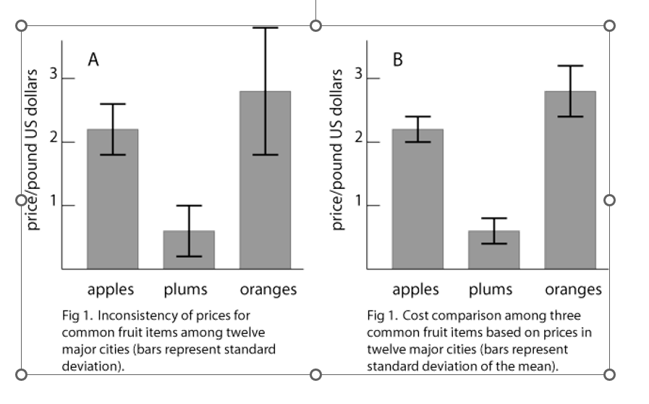
Sampling Error

